Slide 1
OOP Practice Task

Slide 2
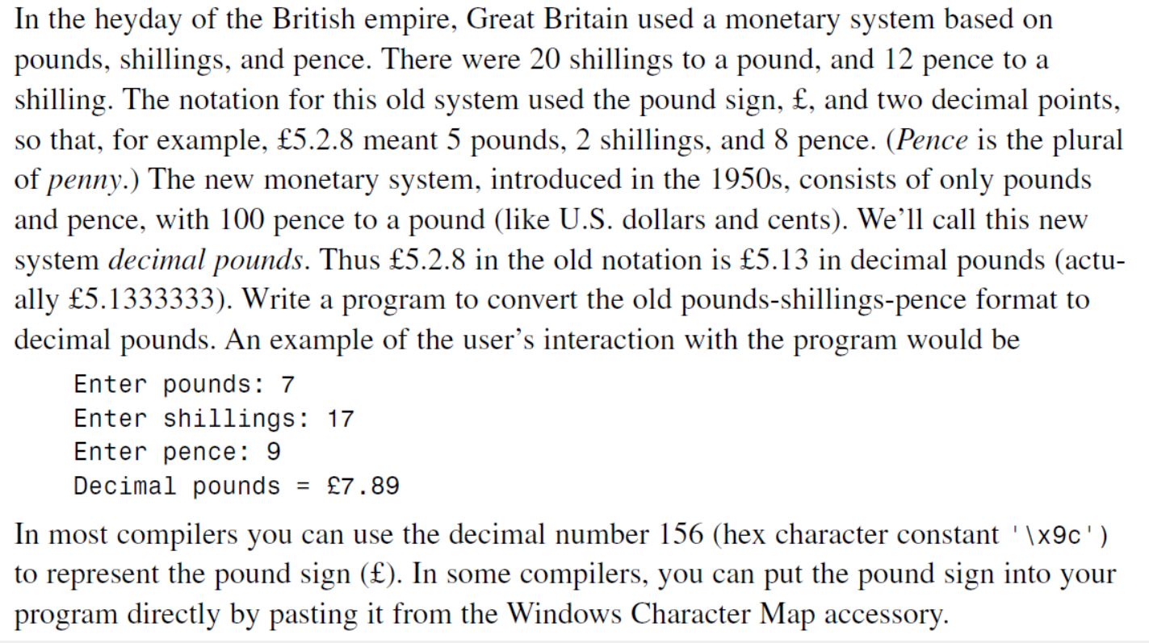

Slide 3
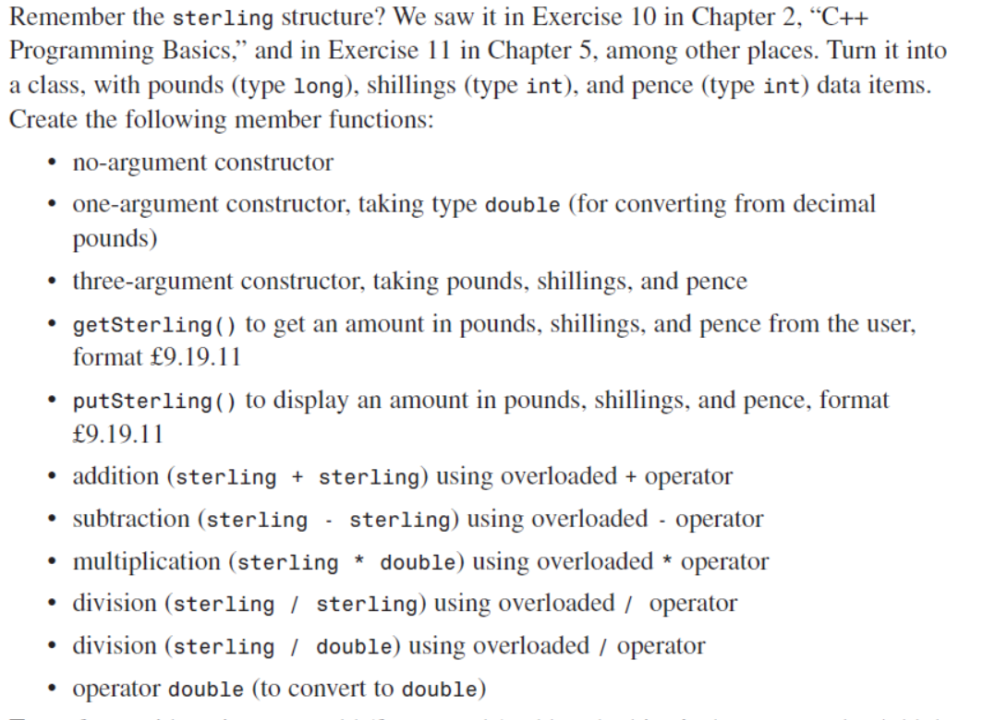

Slide 4

